Slide 1
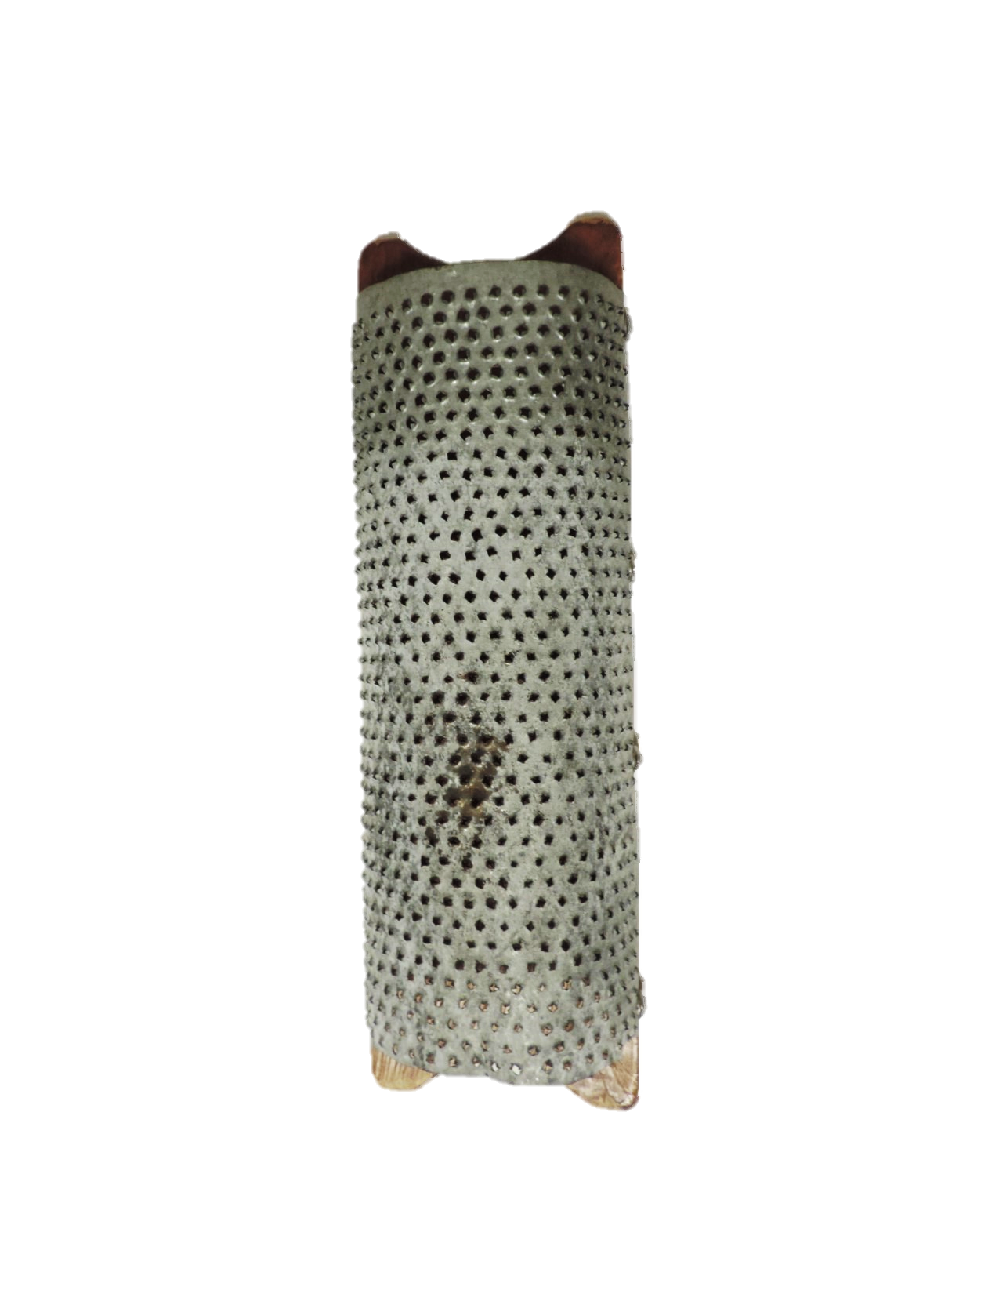
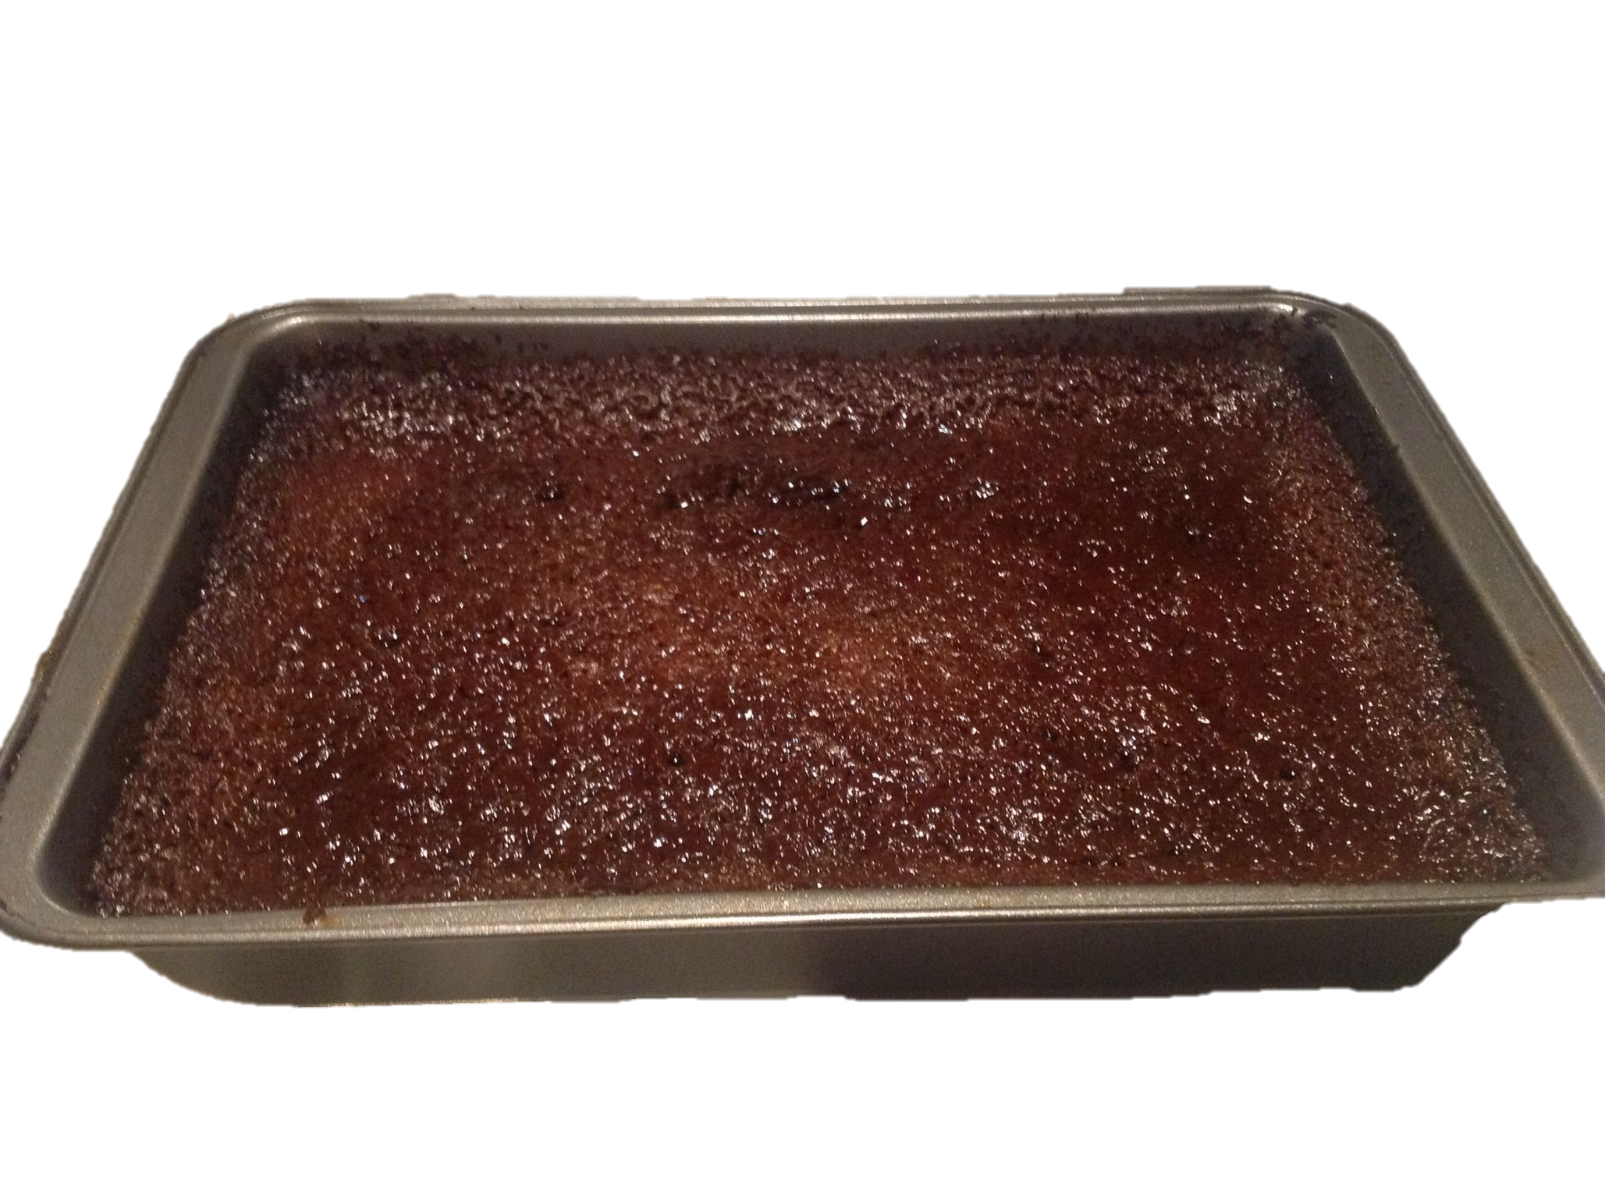
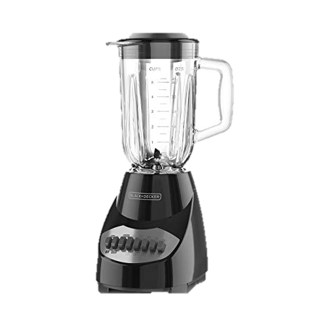
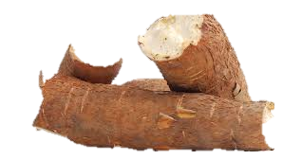
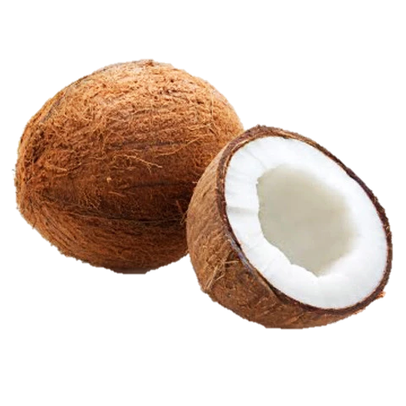
Grater
Filled with tiny nail holes with rough edges, this curved tin sheet was fastened to a wood support and used was used to grate peeled coconut and cassava and other ground provisions for cakes. Can you see what the cake in the picture below is made from?
How does it work?
Cassava
This is a modern Grater.
How does it work?
Coconut

Slide 2
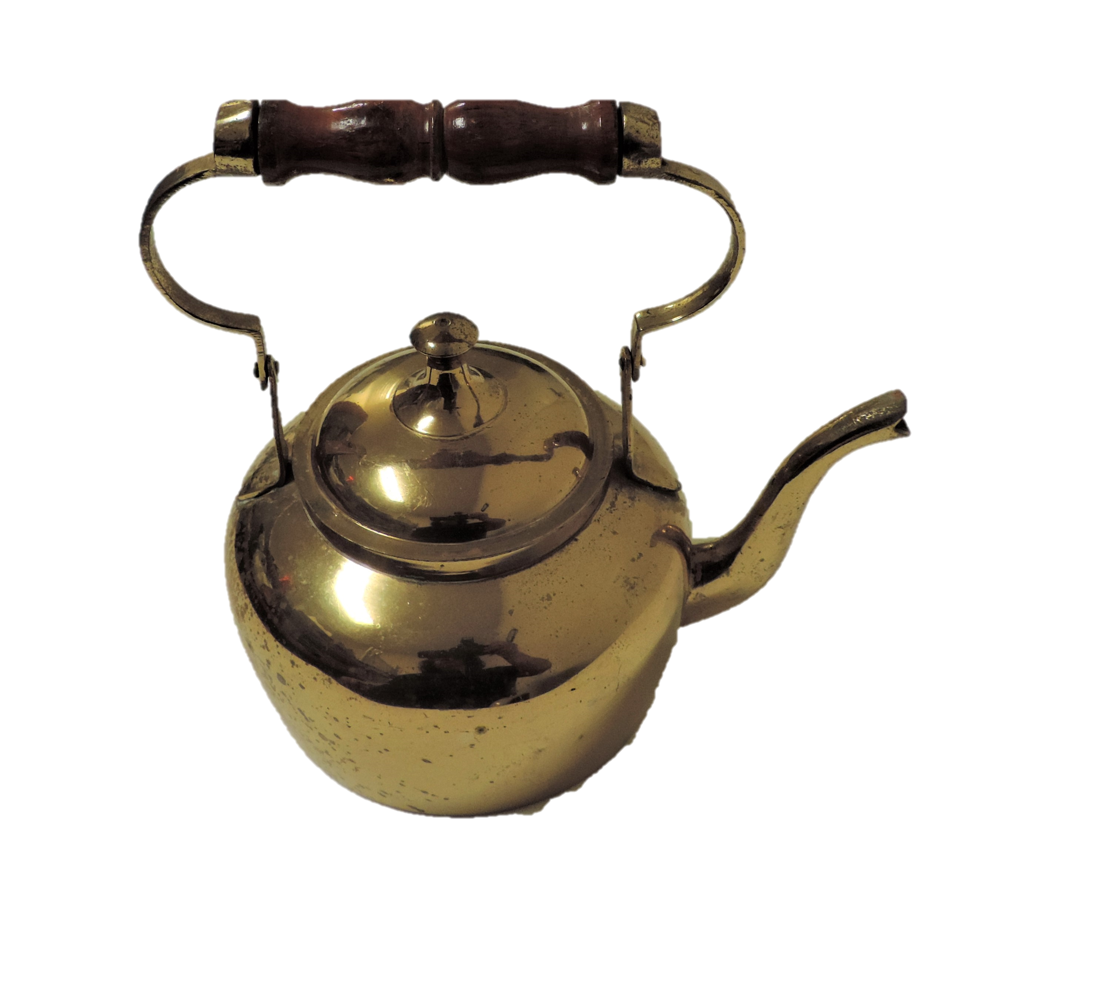
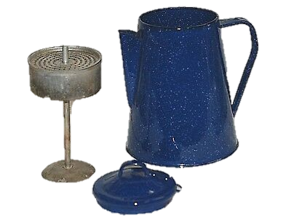
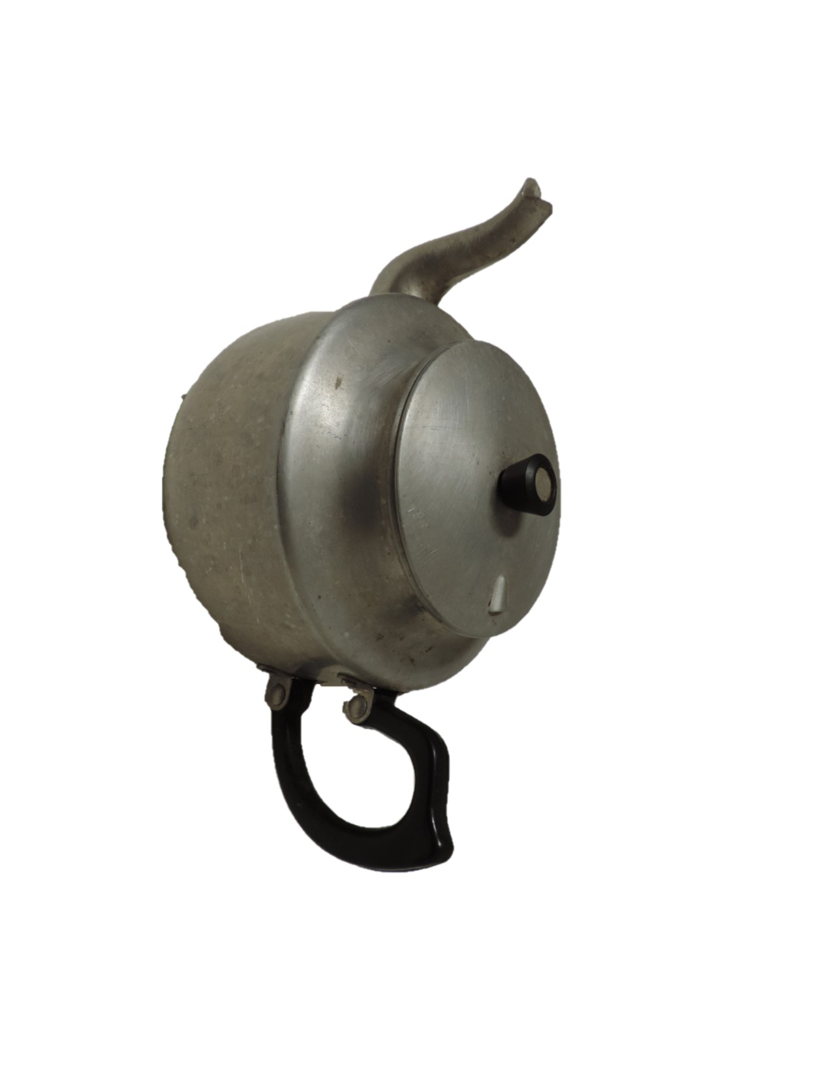
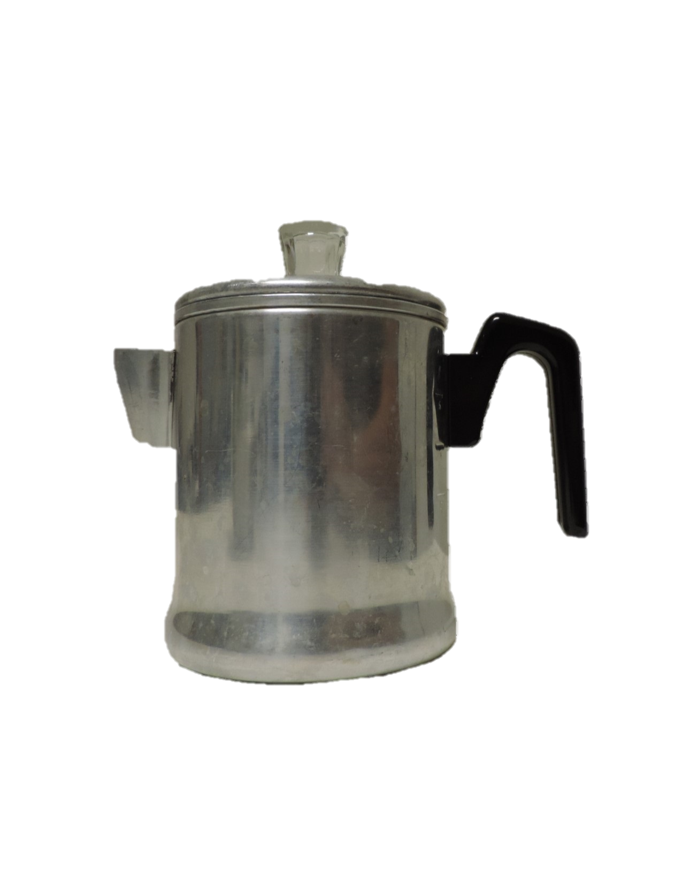
Tea or Coffee Pots
Do you know what plant did Caymanians use for coffee in the early 1900s?
Answer:
D_n_ _ li_ _.
Dark Blue, speckled Graniteware

Slide 3
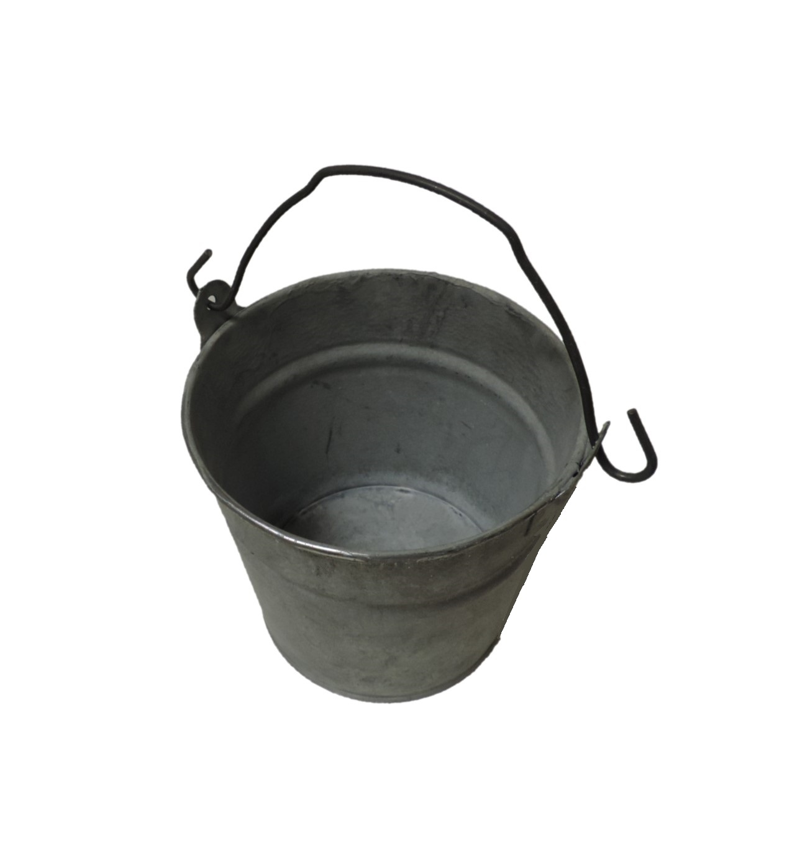
Tin Bucket
In the 1970s, galvanized buckets like this one were found in every household.
They were used to collect water from cisterns and wells.

Slide 4
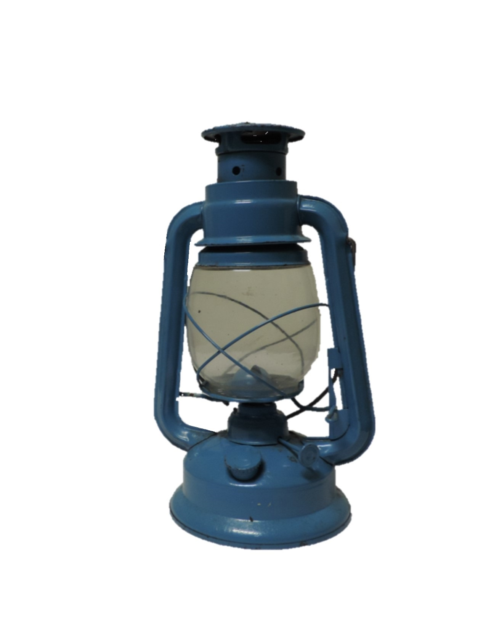
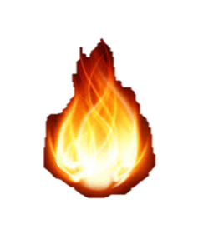
Lantern
This is a common Swallow style lantern from the 1950s. It has a collapsible wire handle and a glass globe. A heavy finger wire lifts the glass globe so that the wick can be lit. These lanterns were often a forest green colour.
Kerosene was used as a lighting fluid. The base of the container is a reservoir and has a capped spout.
Can you find where the kerosene was stored on this lantern?
The moon is a source of light. How did people get light before lamps and lanterns were invented?

Slide 5
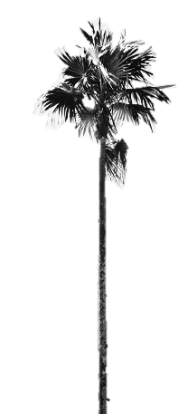
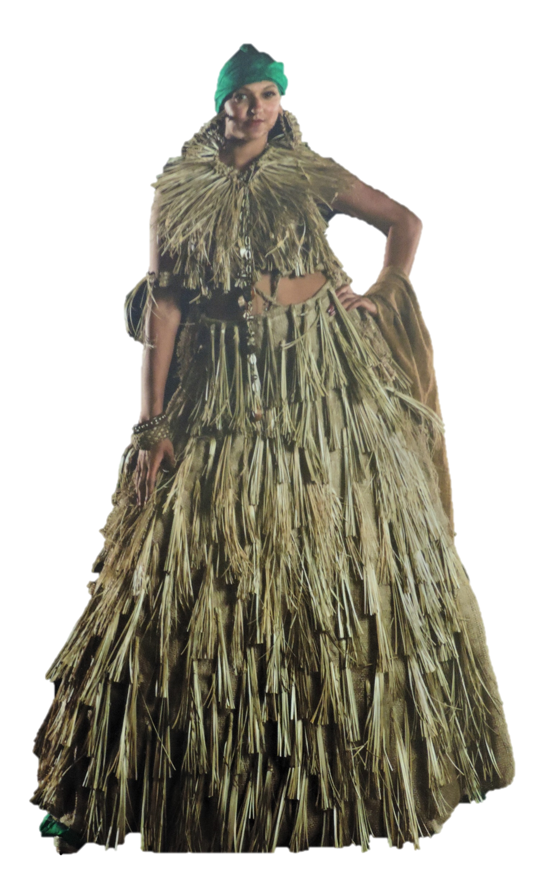
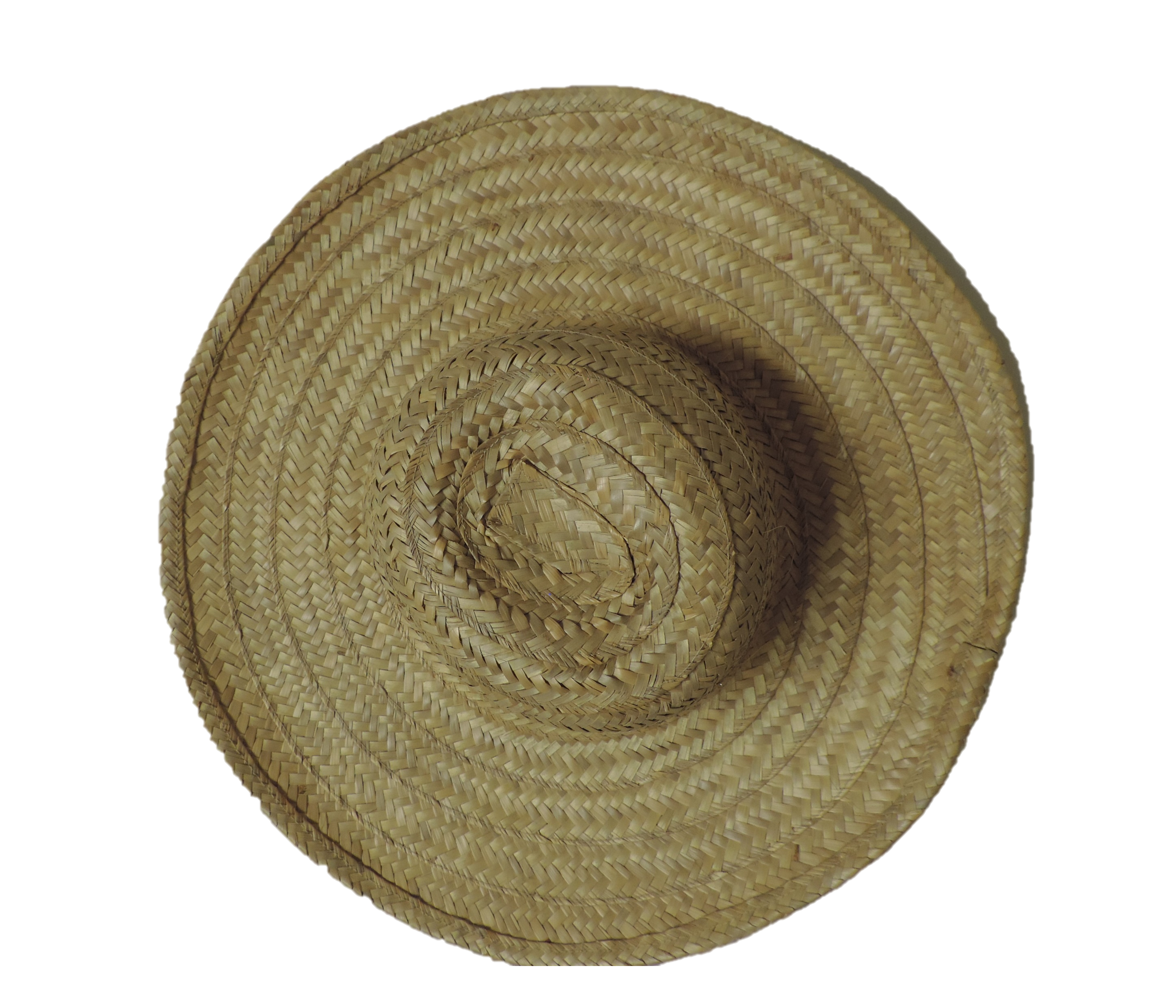
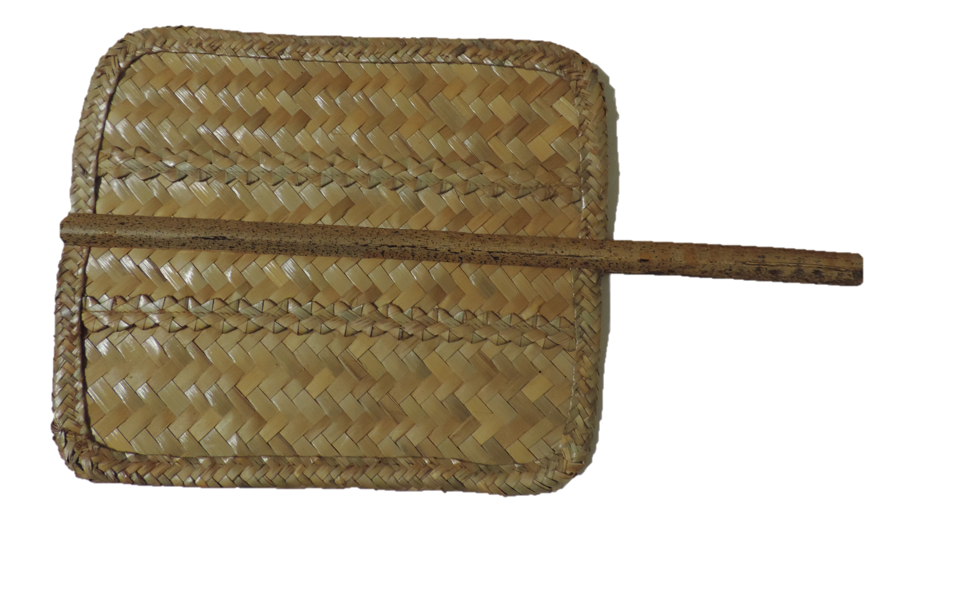
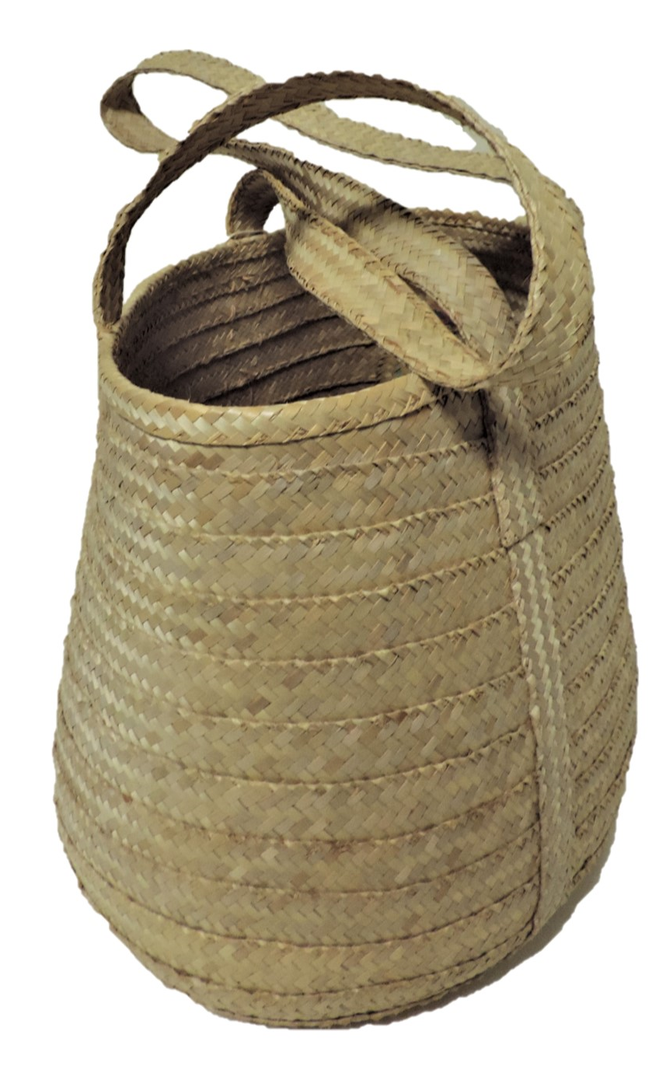
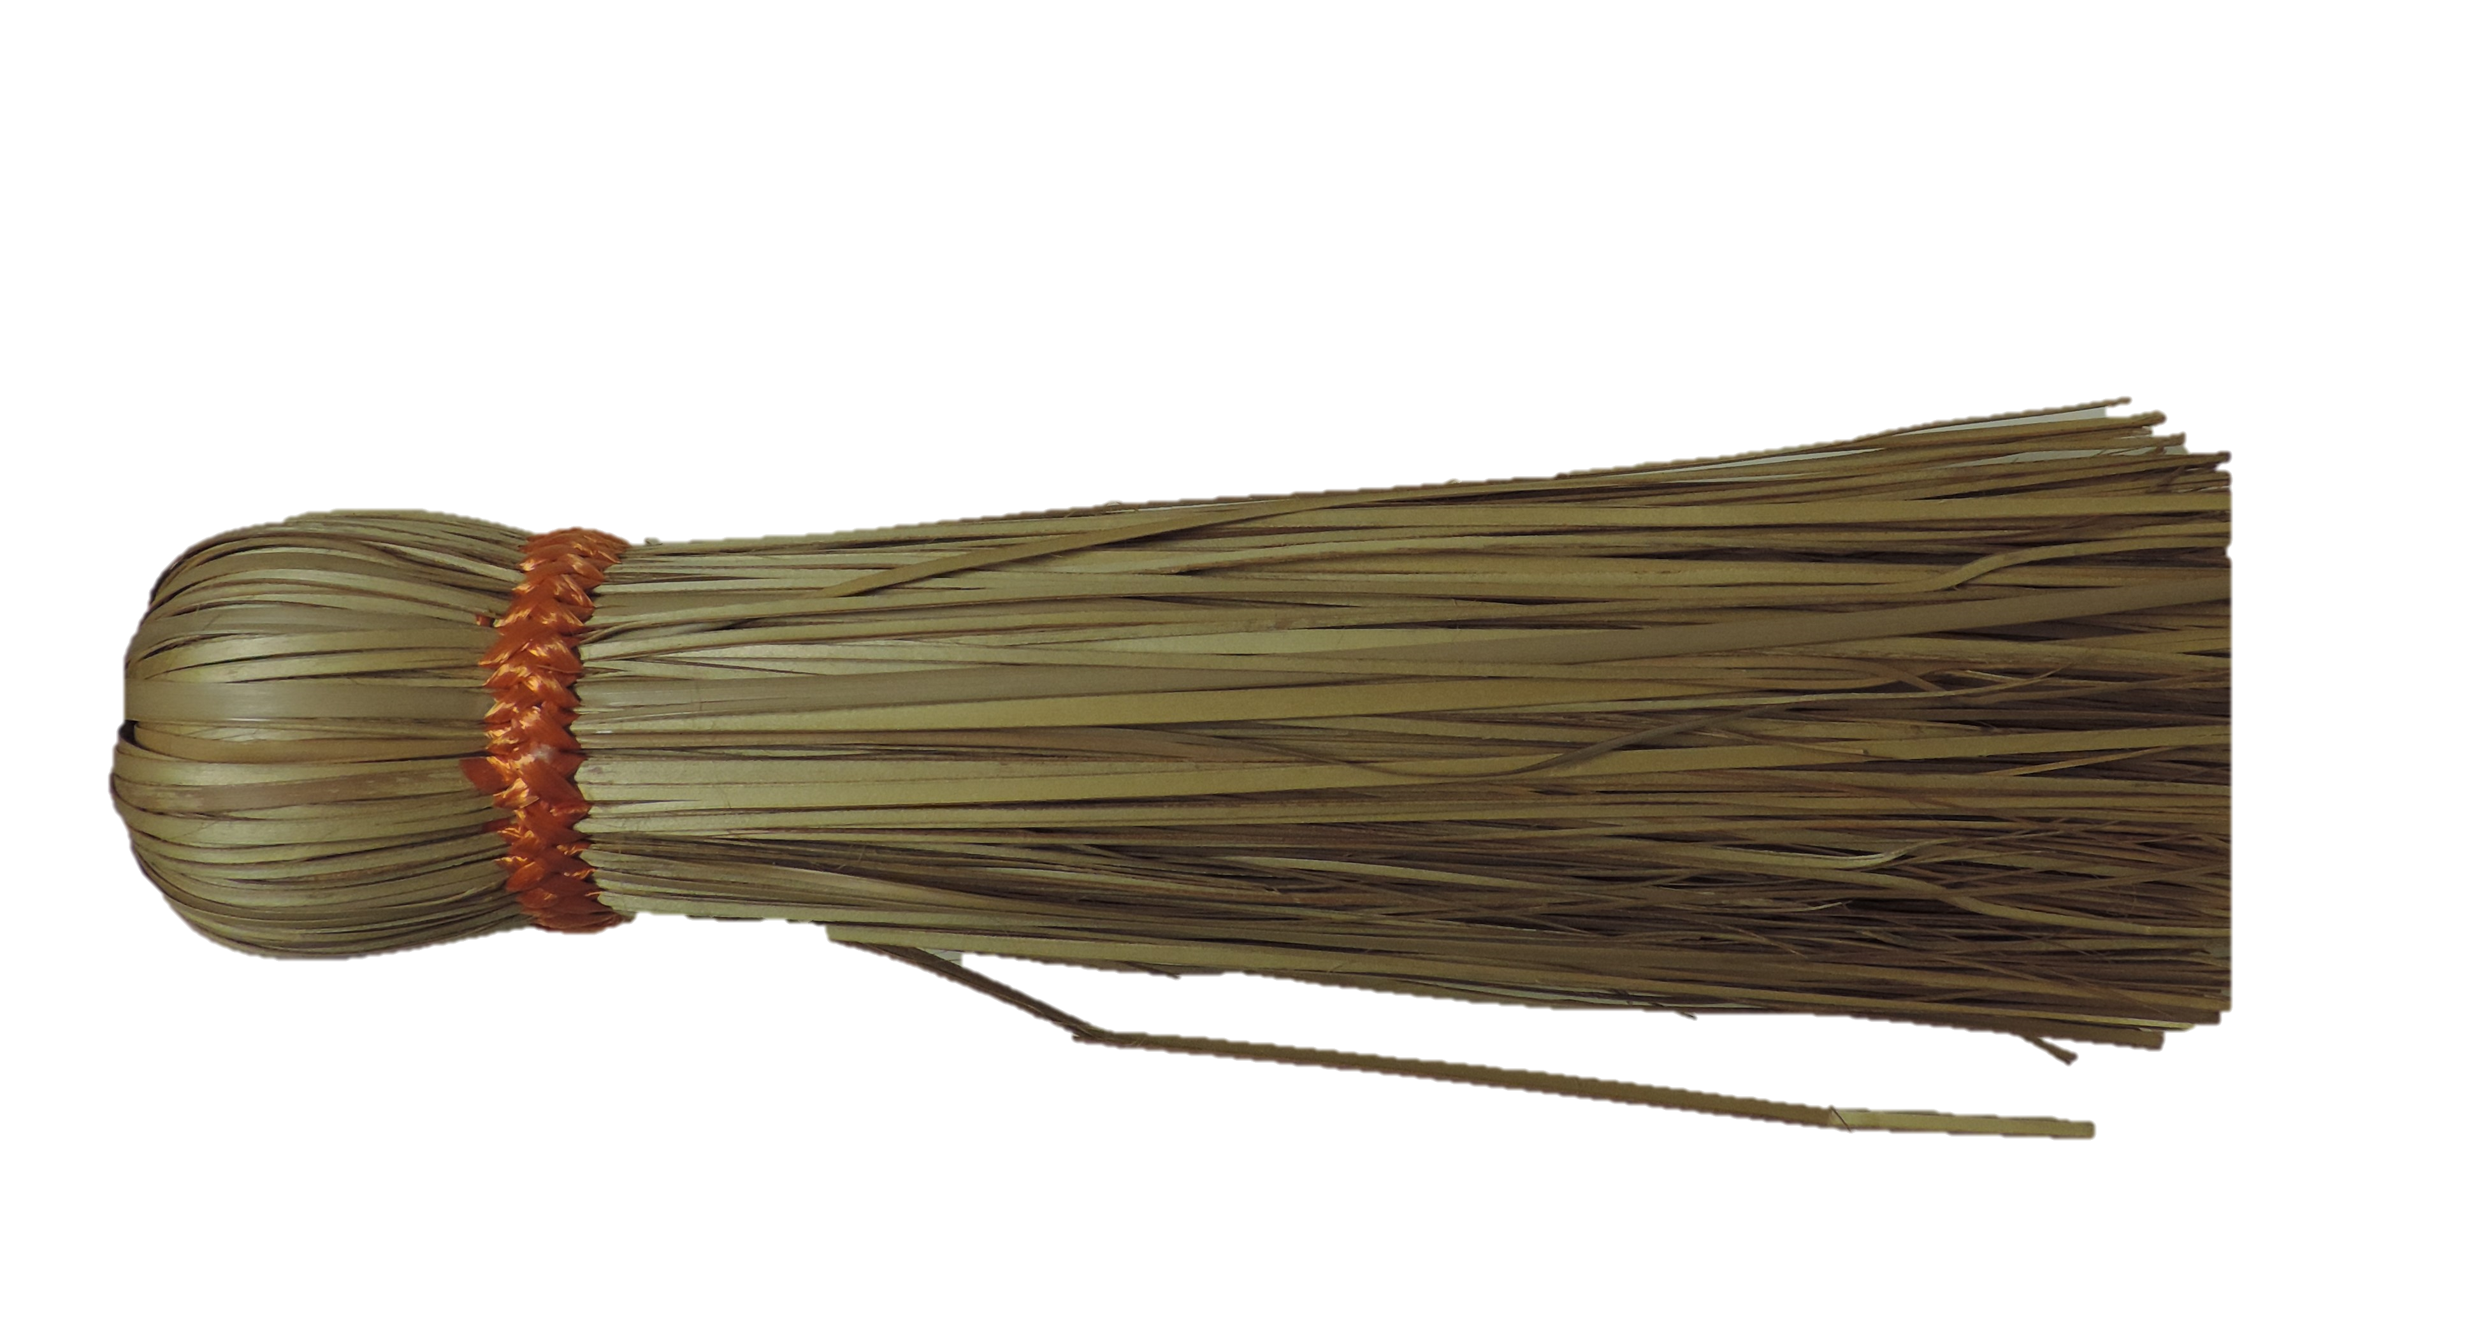
Silver Thatch Palm
Coccothrinax proctorii
This gown was designed by Mrs Virginia Foster.
Here are four things we made from the Silver Thatch Palm:
Fan
What colour is the underside or the back of the silver thatch palm?
Hat
Broom
What is this dress made from?
Basket

Slide 6
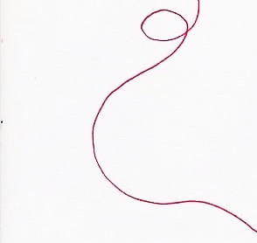
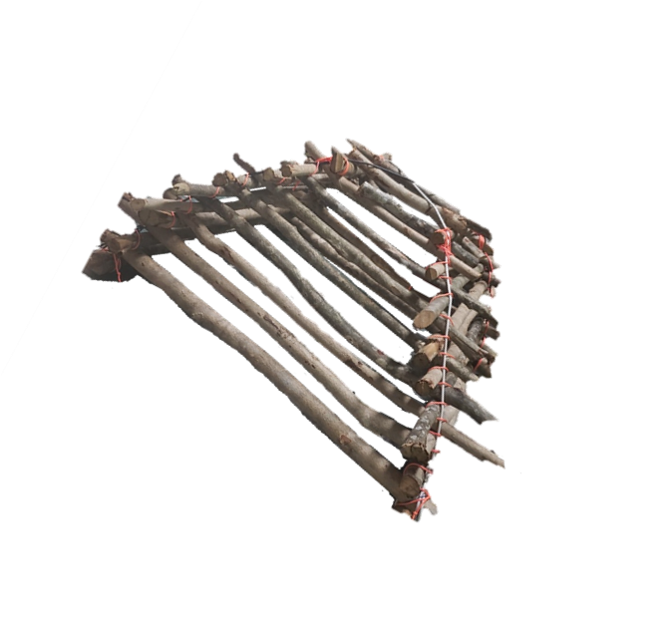
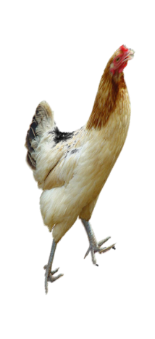
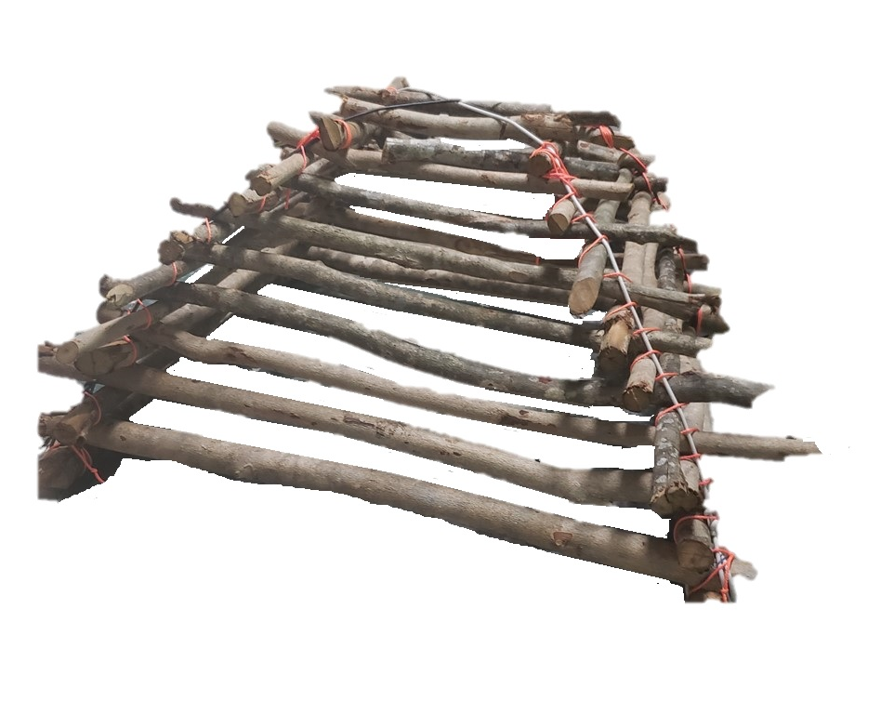
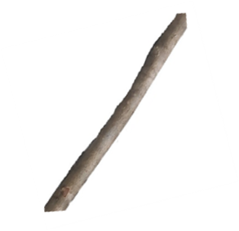
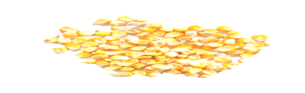
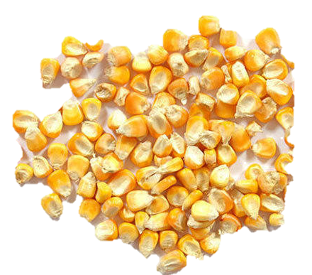
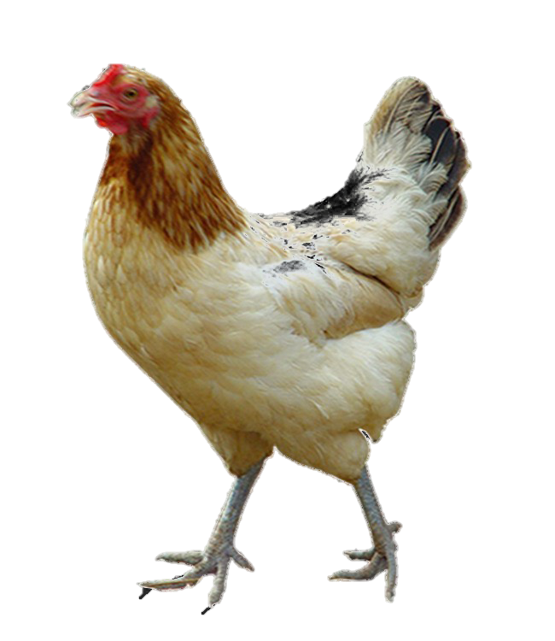
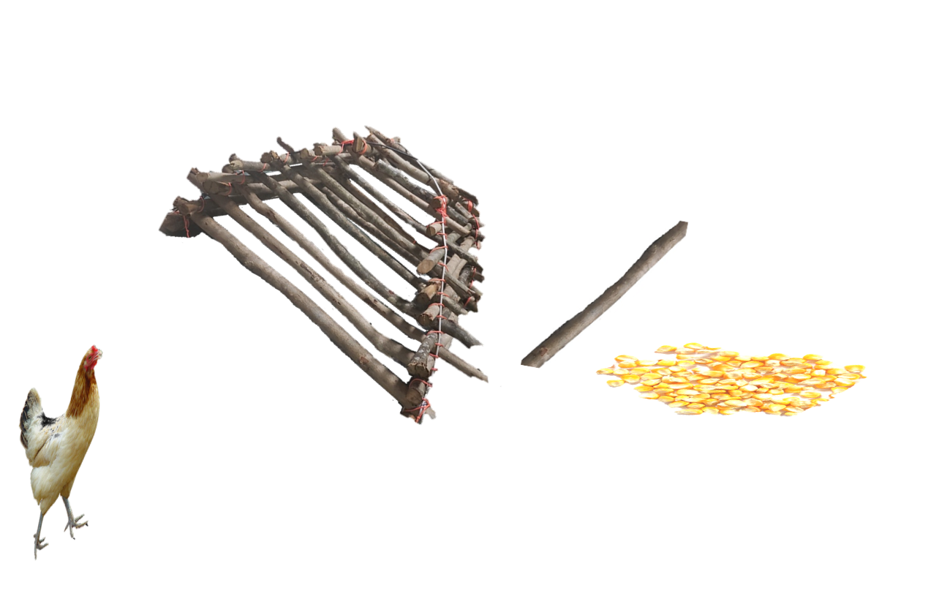
Calavan
The Cayman Calavan is pyramid-shaped and made of sticks. Calavans were used to trap birds, chickens and other small animal sources.

Slide 7
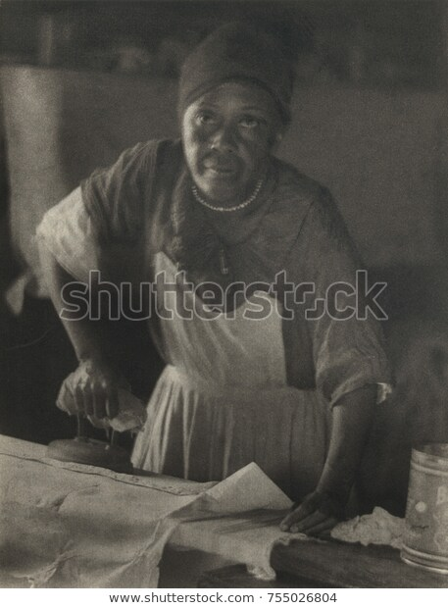
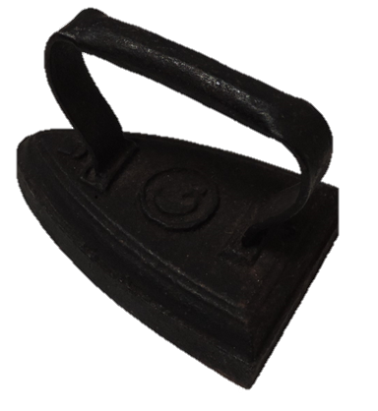
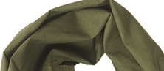
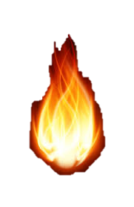
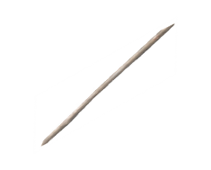
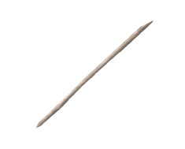
Sad Iron
Sad irons were heated over a stove or open flame and used to press clothing.
Rag
Fire/Heat
Sad Iron
African American woman ironing, ca. 1930. Image by Doris Ulmann. She is best known for her sensitive portraits of rural Southern people between 1928-1934.

Slide 8
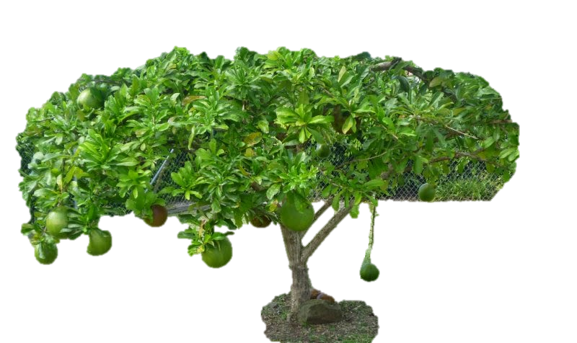
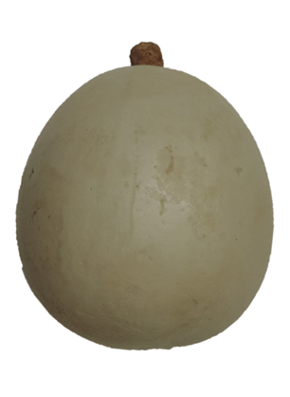
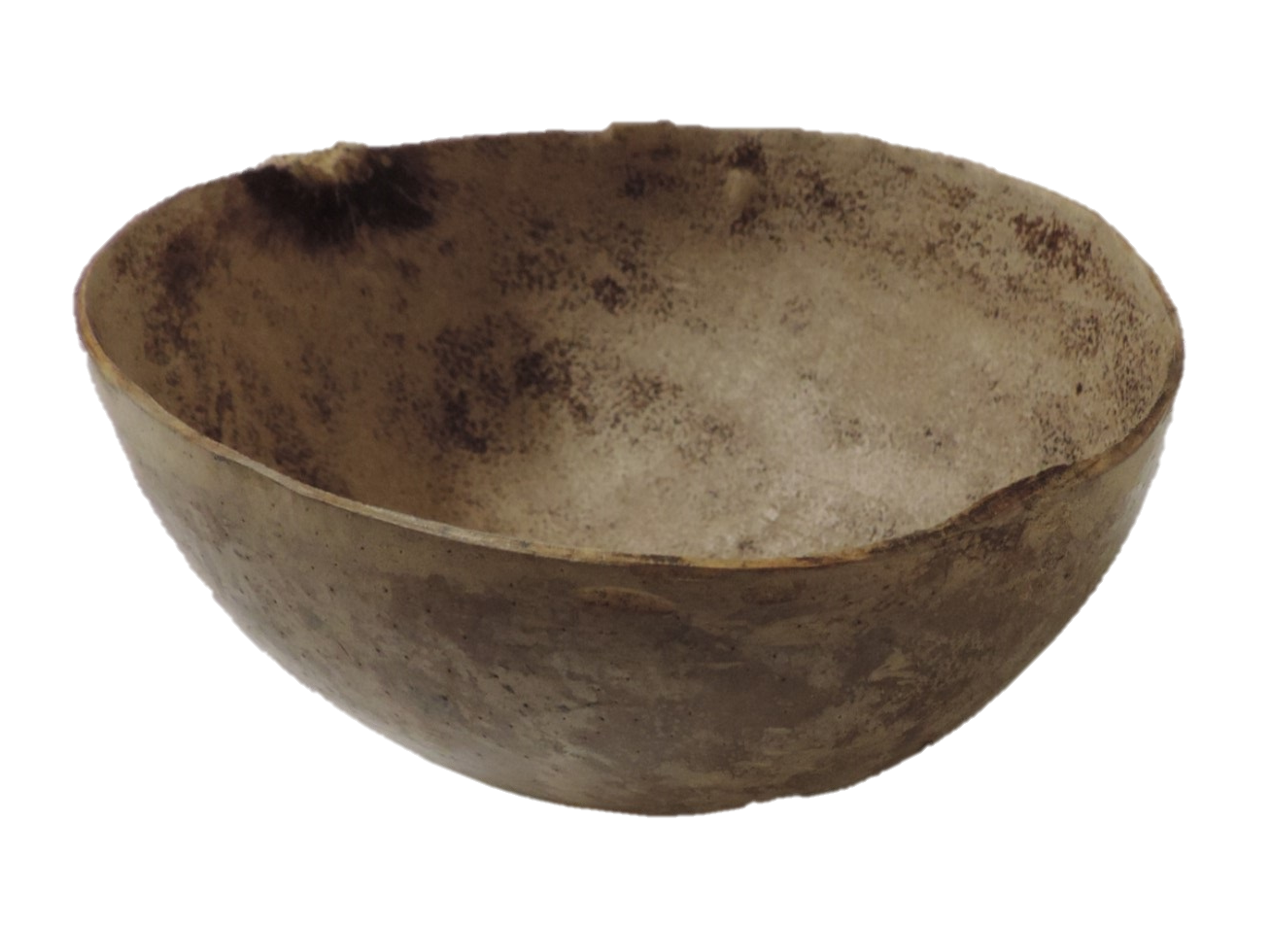
Water Bottle
This once was a brown Calabash. Calabashes or Gourds grow on trees. After a calabash is picked and left to dry, a small hole is made at the top of the hard shell. The nut inside of the shell is chipped up and shaken out until all of the contents inside are gone. The hollow gourd is cleaned and used to store water. This bottle was bleached by Ms Virginia Foster.

Slide 9
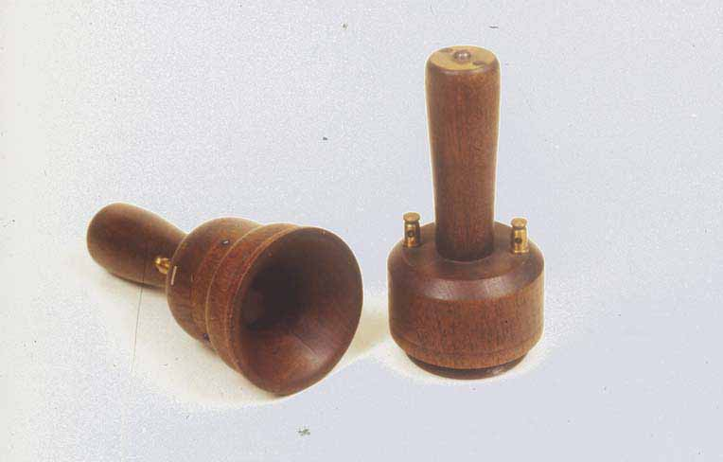
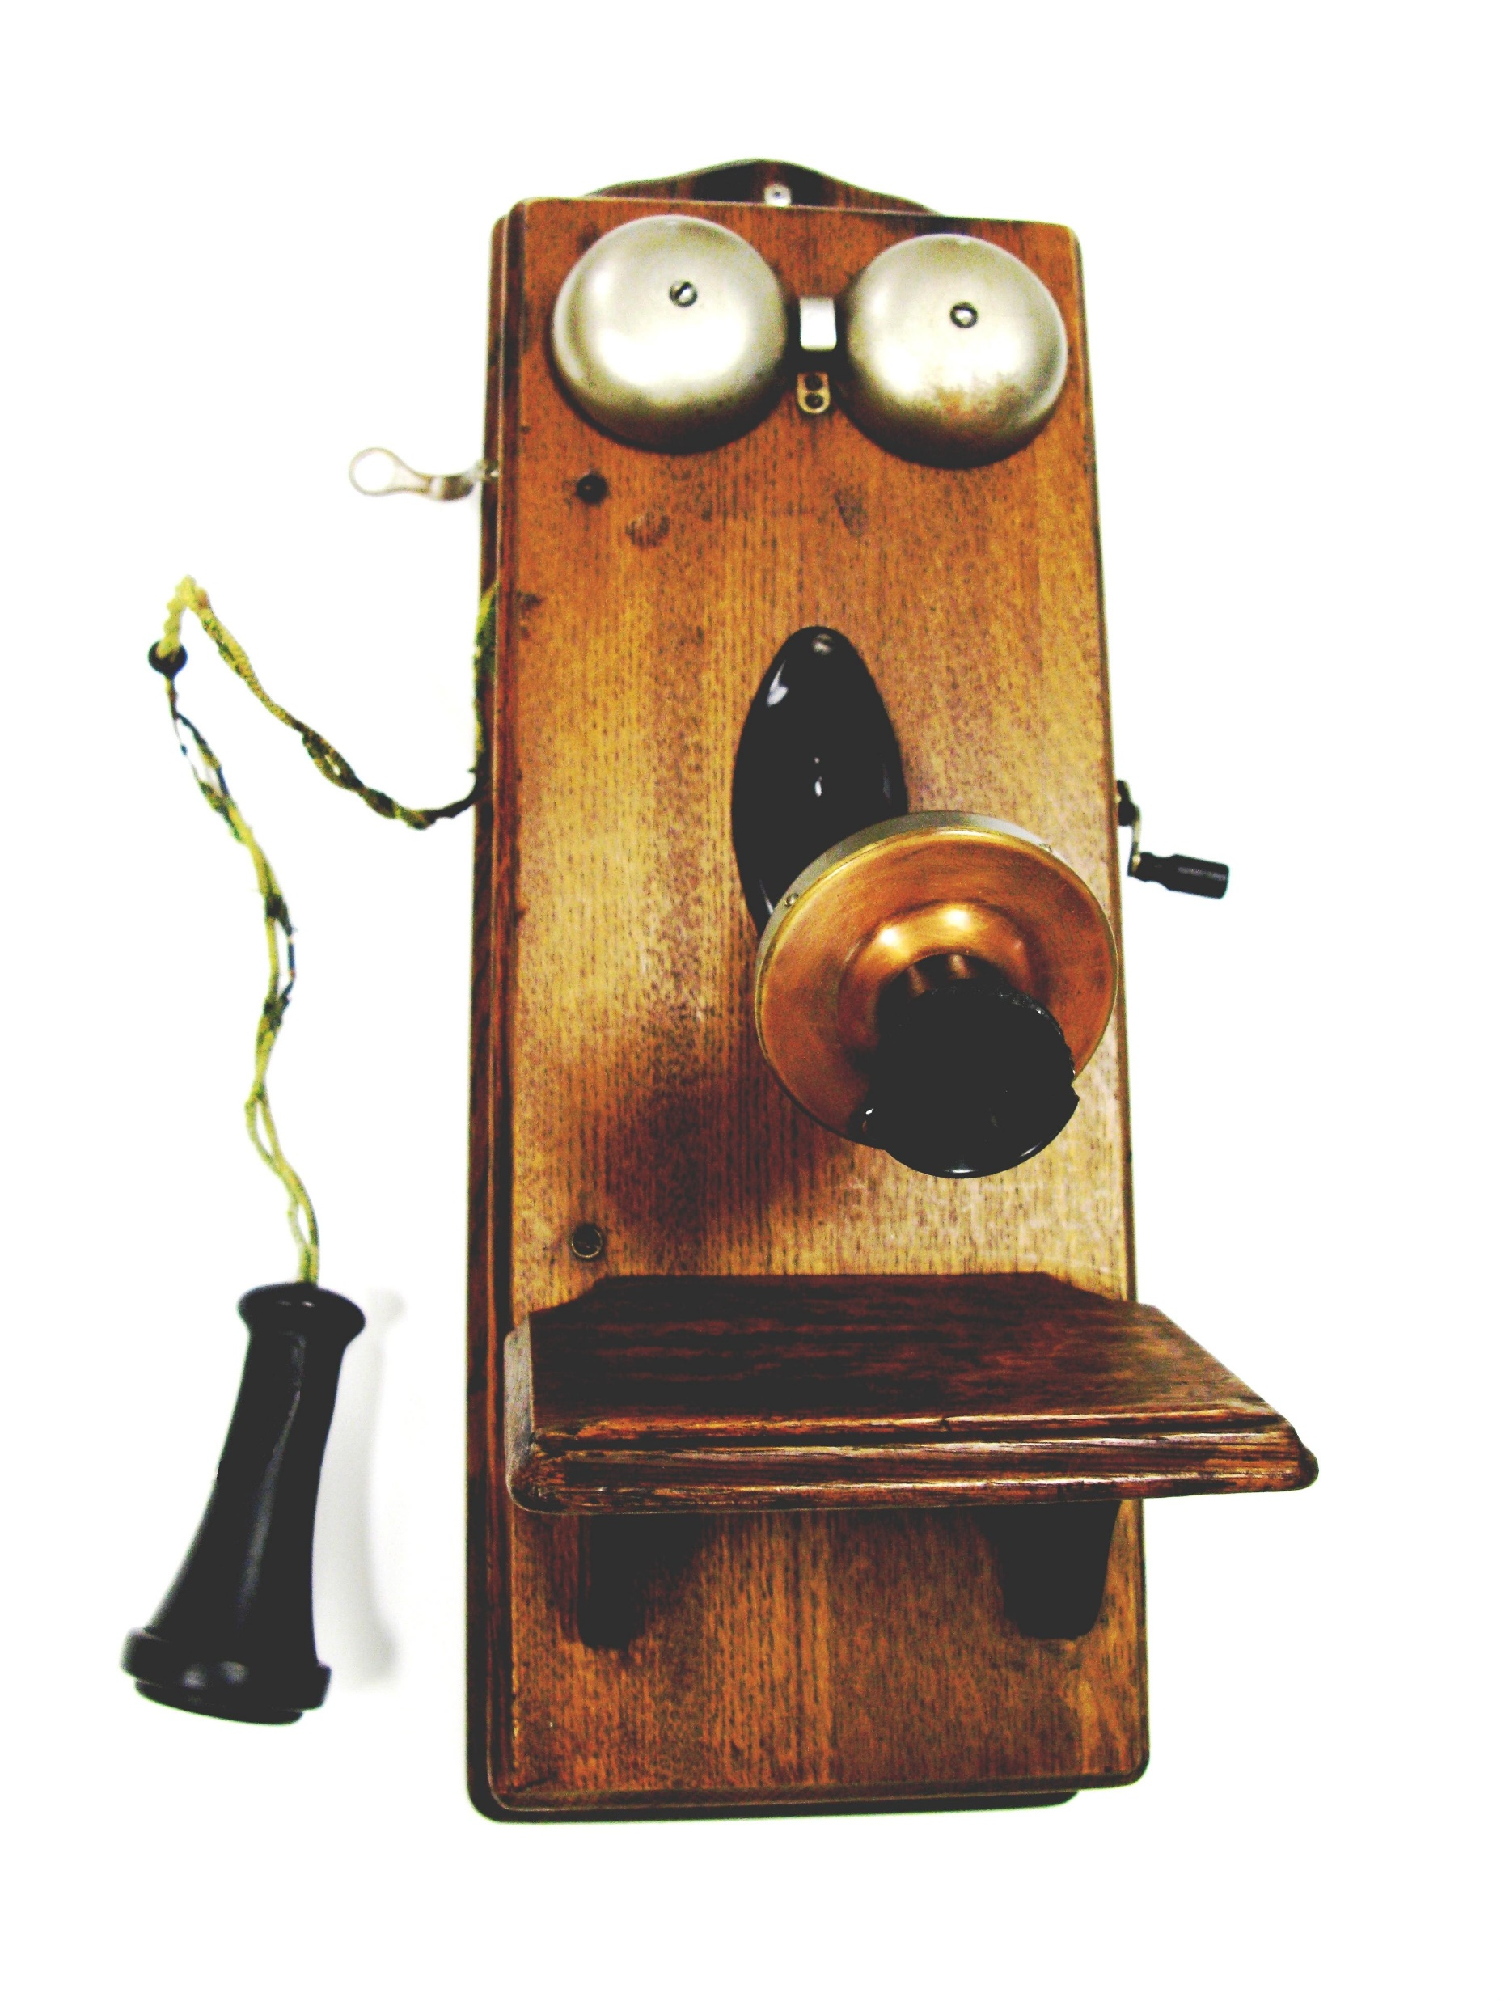
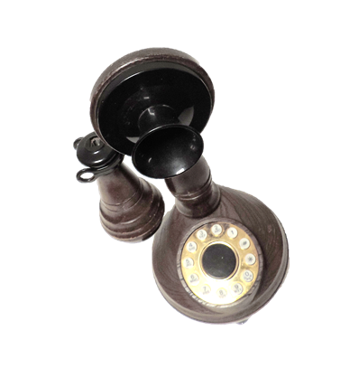
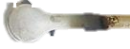
Telephones
This CandleStick Telephone dates to the late 1890 through 1940s. These phones were not common in Cayman. The earliest telephones in Cayman were crank telephones.
Question: What is this?
Answer: THE WORLD'S FIRST TELEPHONE
Invented by Italian born Antonio Meucci
in 1849 in New York.
1950s Crank telephone used by the Cayman Islands Customs Department in the 1950s.

Slide 10
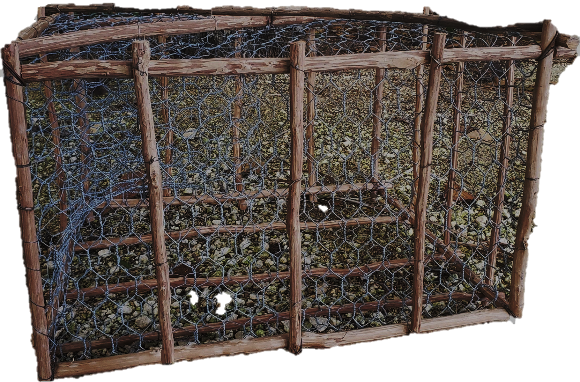
This is a cage for trapping fish. We called it a Fish Pot.
When it is placed in the sea and secured with kellicks or, large rocks.
Smelly, stinky bait was placed inside the pot.
Hungry fish like Snappers, Groupers, Squirrel Fish and others swam into the large opening and became trapped. The mesh allowed baby fish to swim in and out.
Fish Pot
What’s wrong with this picture?

