Slide 1
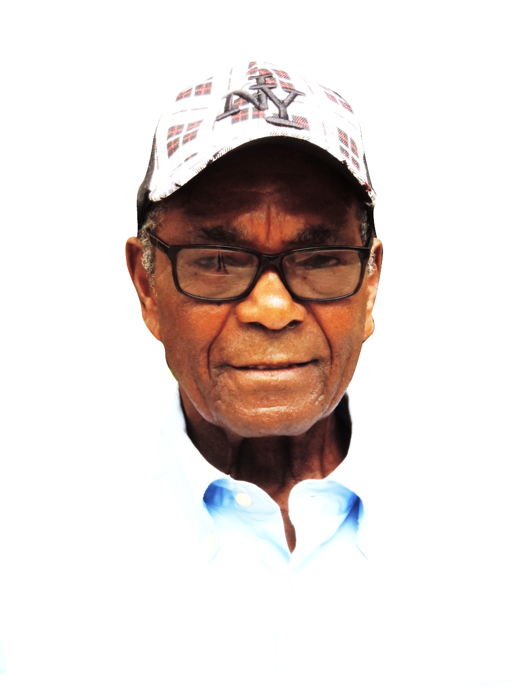
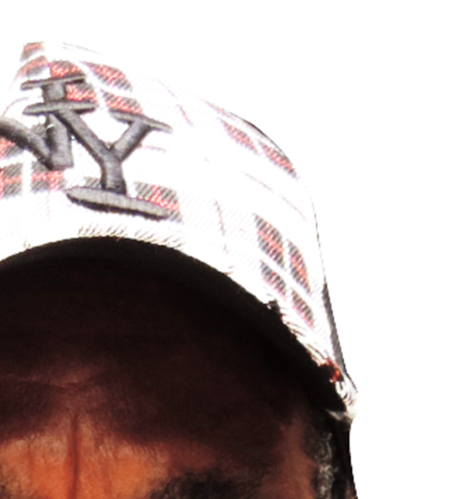
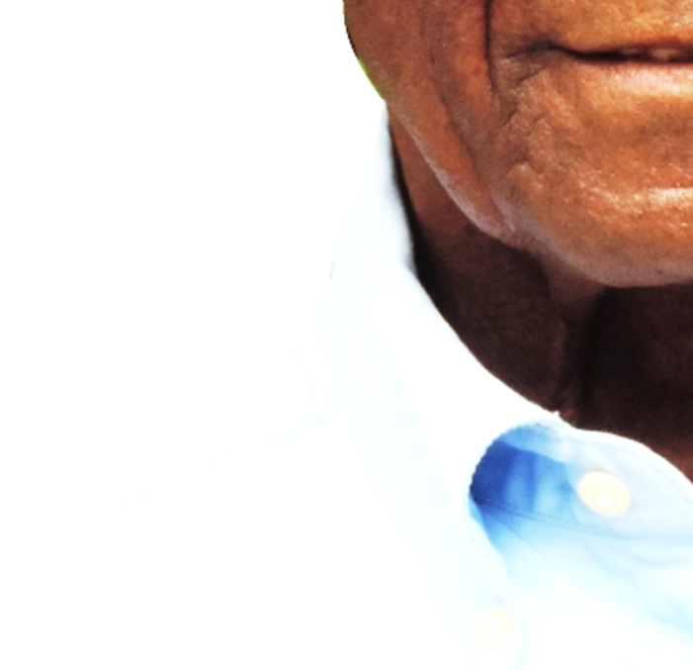
WHO AM I?
Fish pots, calavans and nets provided the means for us to trap food sources. Fifi’s provided light for hunting crabs at night.
Cast Net, Seine Net, Trap Net, Hammock, all them I make and more..
Who Am I? I was born in East End. And I received a Cultural Heritage Award in 2020.
Use your Research Skills: Ask someone, search the local newspaper or search the internet.
Instructions. Print and cut-out the six images below. On another sheet of paper, place each image in the correct position to complete the picture above.

